Slide 1


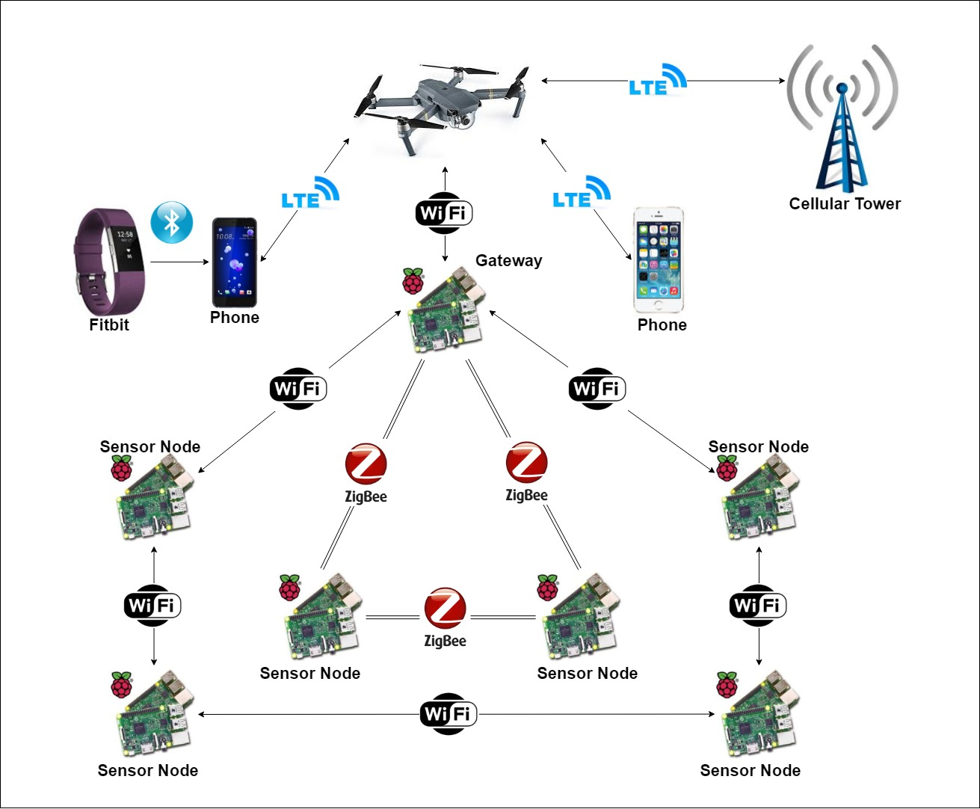
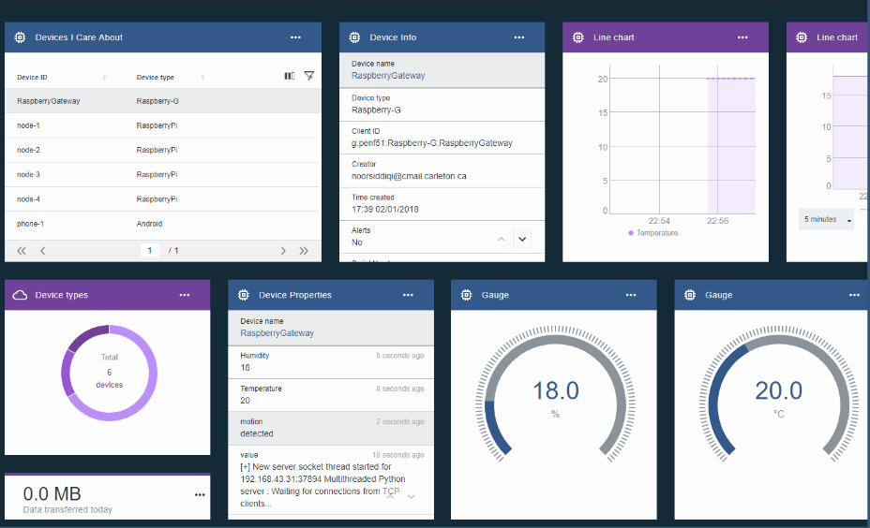
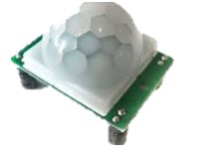
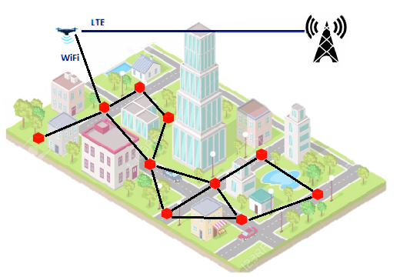
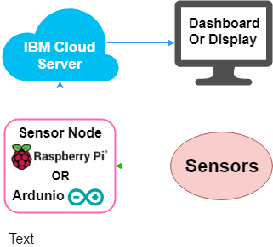
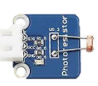
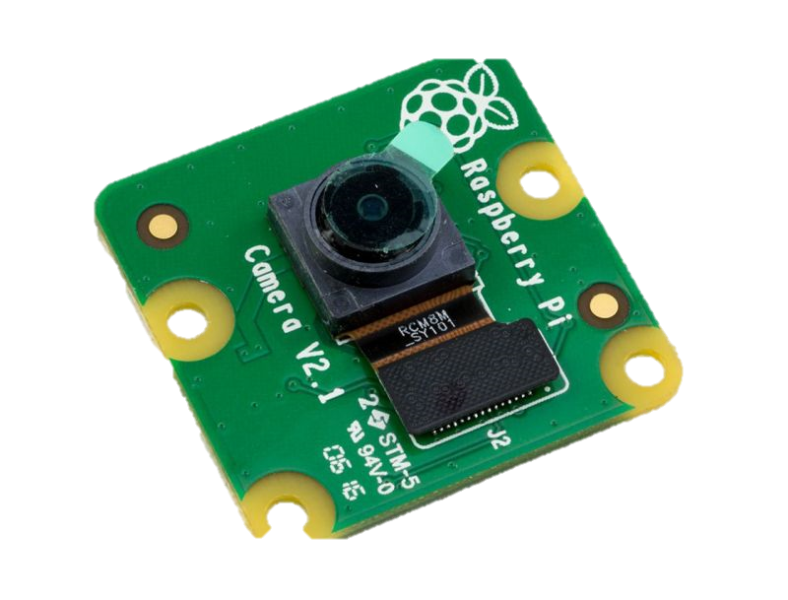
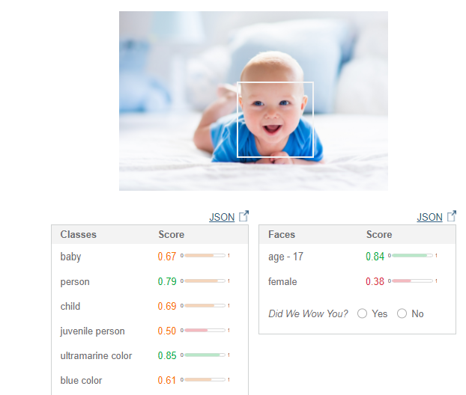
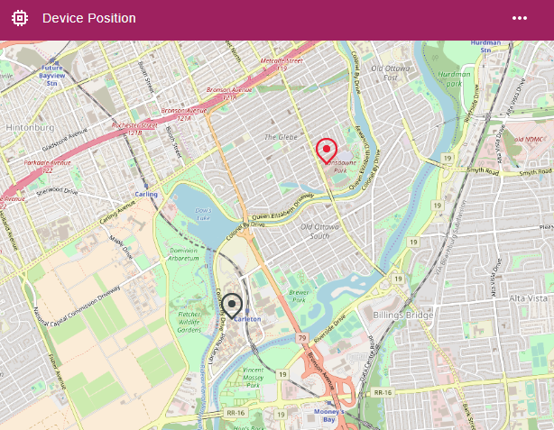
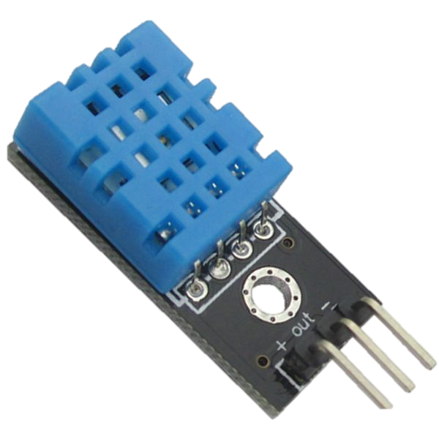
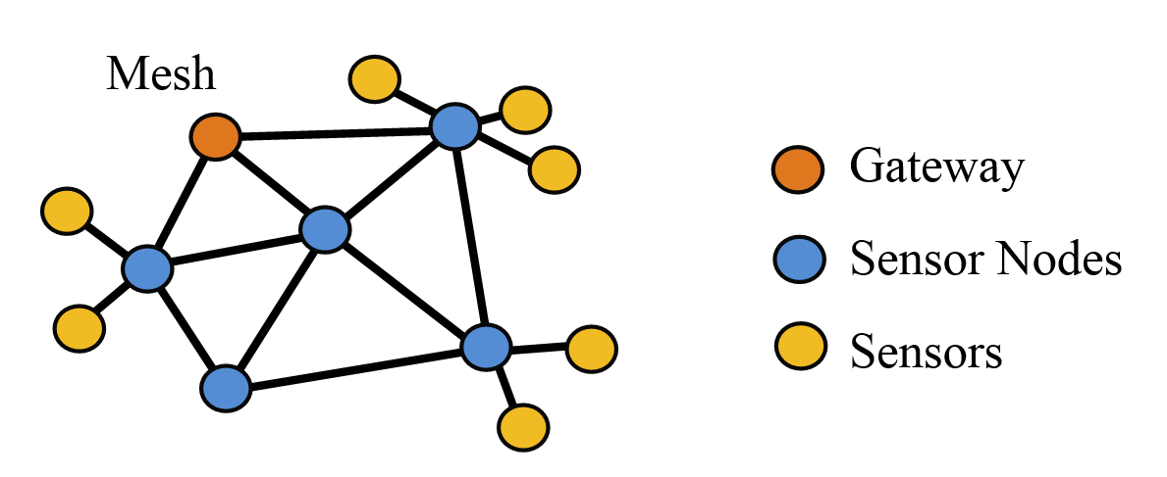
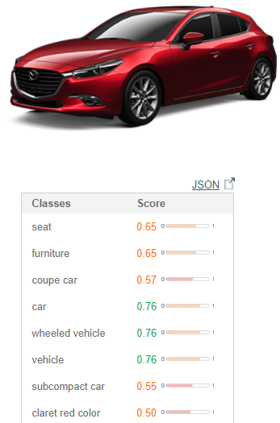
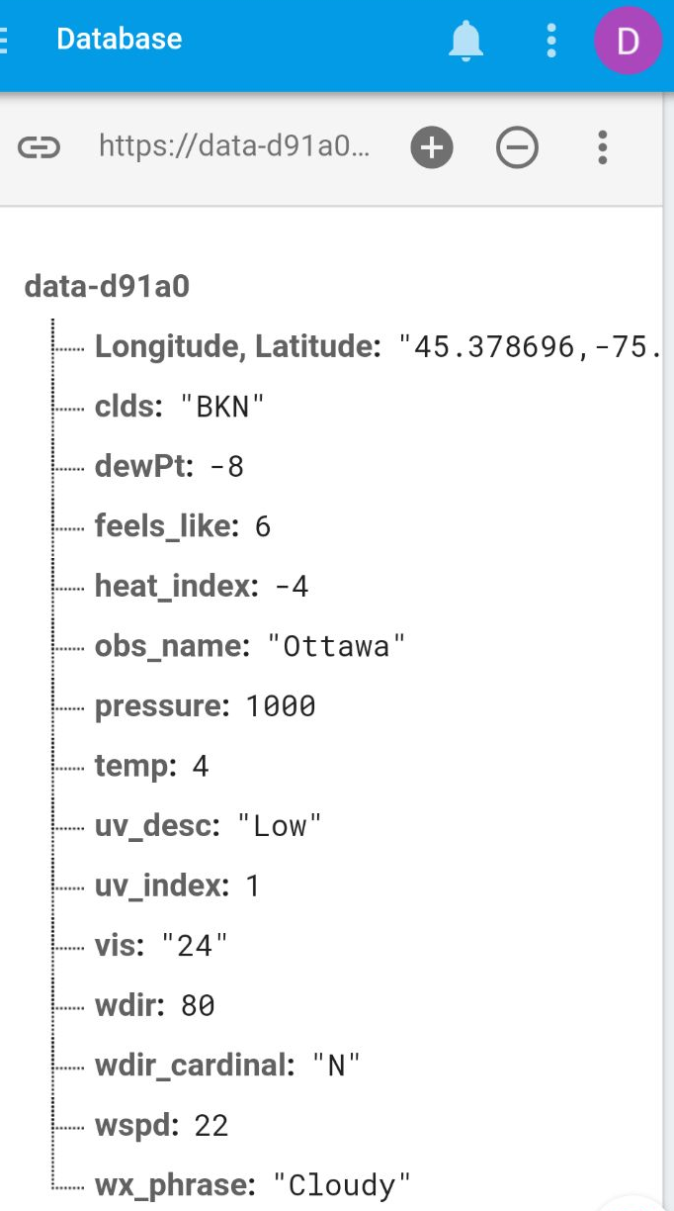



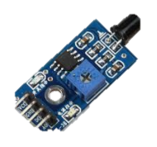
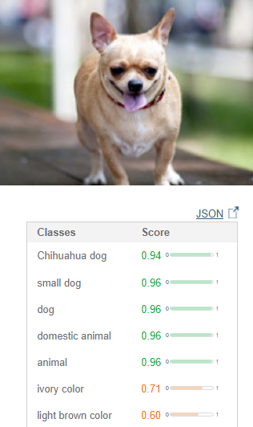
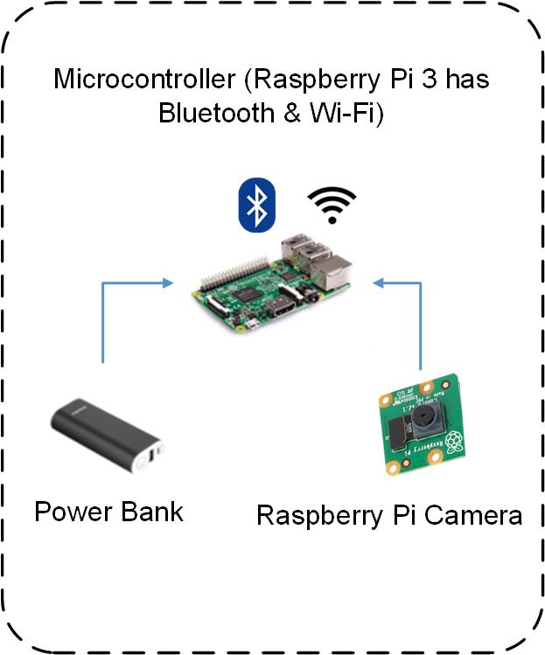
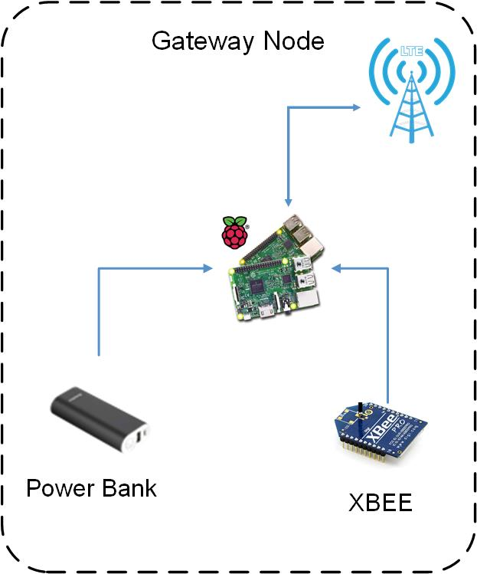

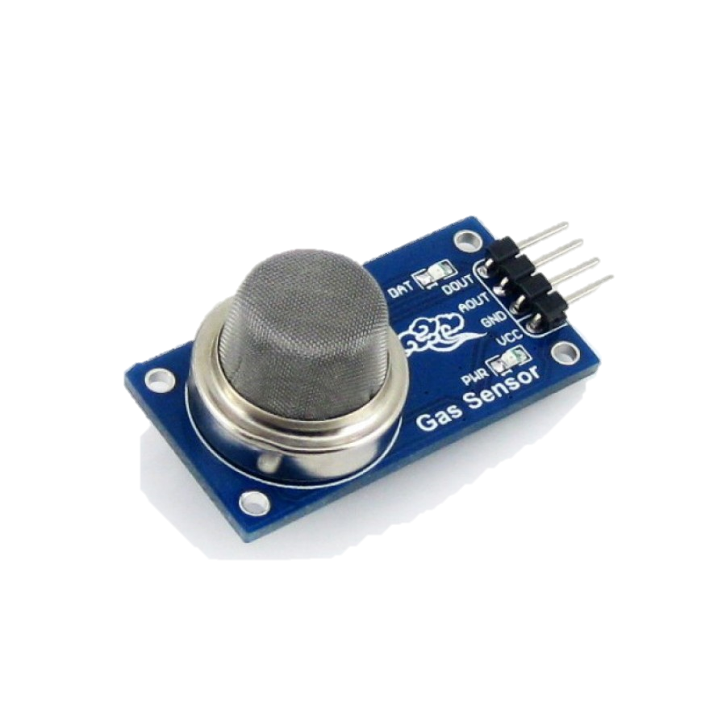
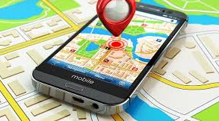
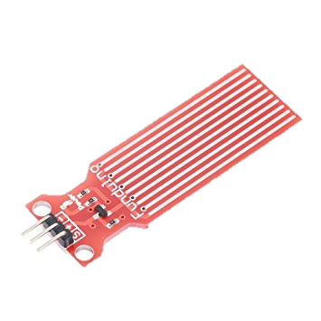
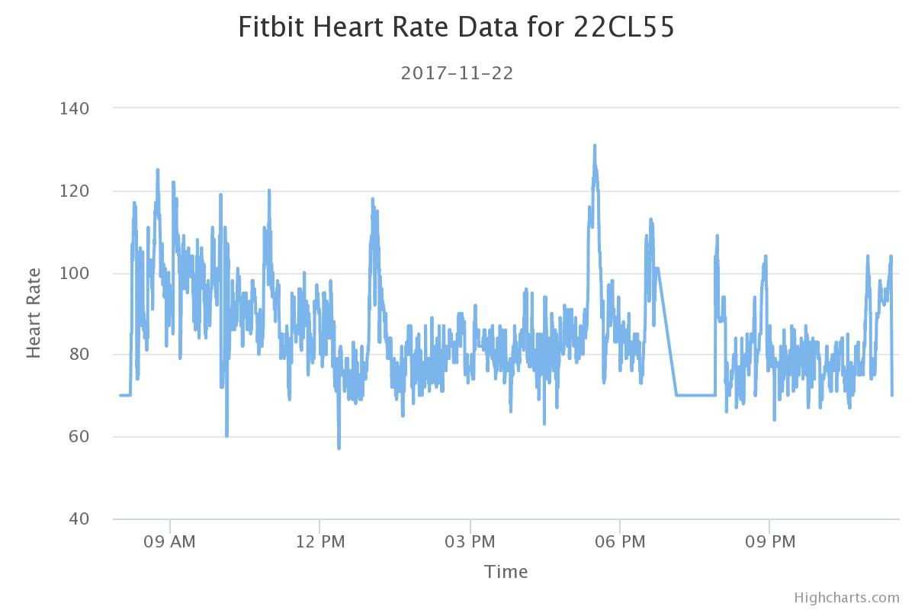
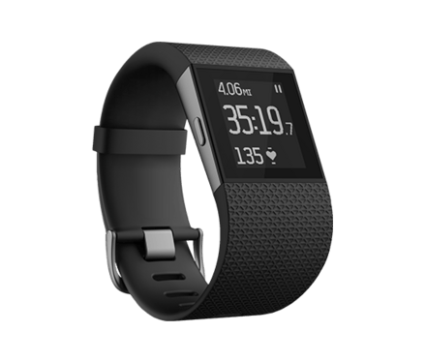
Internet of Things For Disaster Response
Group 16
Supervisor: Professor Mohamed Ibnkahla
Second Reader: Professor Xiaoping Liu
Co-Supervisor: Dr. Zied Bouida
Shahad Abbas
Mourad Hussein
Amr Gawish
Noor Siddiqi
Objectives
System Architecture
Data Visualization
Viable system for disaster response
Reliable communication method for response teams
Scalable prototype
Uses heterogeneous system
Data collection and display
Data Representation
Background
Motion
Light
Visual Recognition
Device Mapping
Mesh Network Advantages
Connect nodes together
Scalability
Reliability
High Range
Low Power Consumption
Multiple Wireless Networks
Reduces network overcrowding
Increases reliability
Increase number of messages traveling through the system
Camera
Data Displayed on App
Humidity
& Temperature
Achievements
Flame
Multiple sensor nodes
Multiple sensors
Mesh network using Wi-Fi / ZigBee / Bluetooth
Data Visualization and analysis through IBM Cloud
Data Storage on Cloudant & Firebase
Data display on mobile phone
Gas
Fitbit Heart Rate Data
GPS
2017 - 11 - 22
Future Improvements
Live video streaming
Autonomous power supply
Software Defined Networking for Traffic Control
Increase number of sensors to include microphone / speaker / etc.
Water Level
Pulse
Notes:
Each group's posters must minimally must include:
A title page, identifying the project's title and group number, the supervisor and the students.
An introduction that identifies the major goals of the project.
A concise and specific summary of the major contributions or achievements of the project.
A description or list that clearly identifies the contributions of each individual: which student did which _{p==ortion} of the project.
http://sce.carleton.ca/courses/sysc-4907/4thProjectPosterFair.html
Abstract (in case we need it later)
Build a scalable prototype heterogeneous system to be used in disaster environments to gather data from the environment and the people.
The system will collect data from sensor nodes, in order to detect emergencies, provide a reliable data communication method, and visualize and analyze the data to reduce the time taken for decision making

